Slide 1
Building a Custom Rod
Part 6
By JOHN STURM

Slide 2
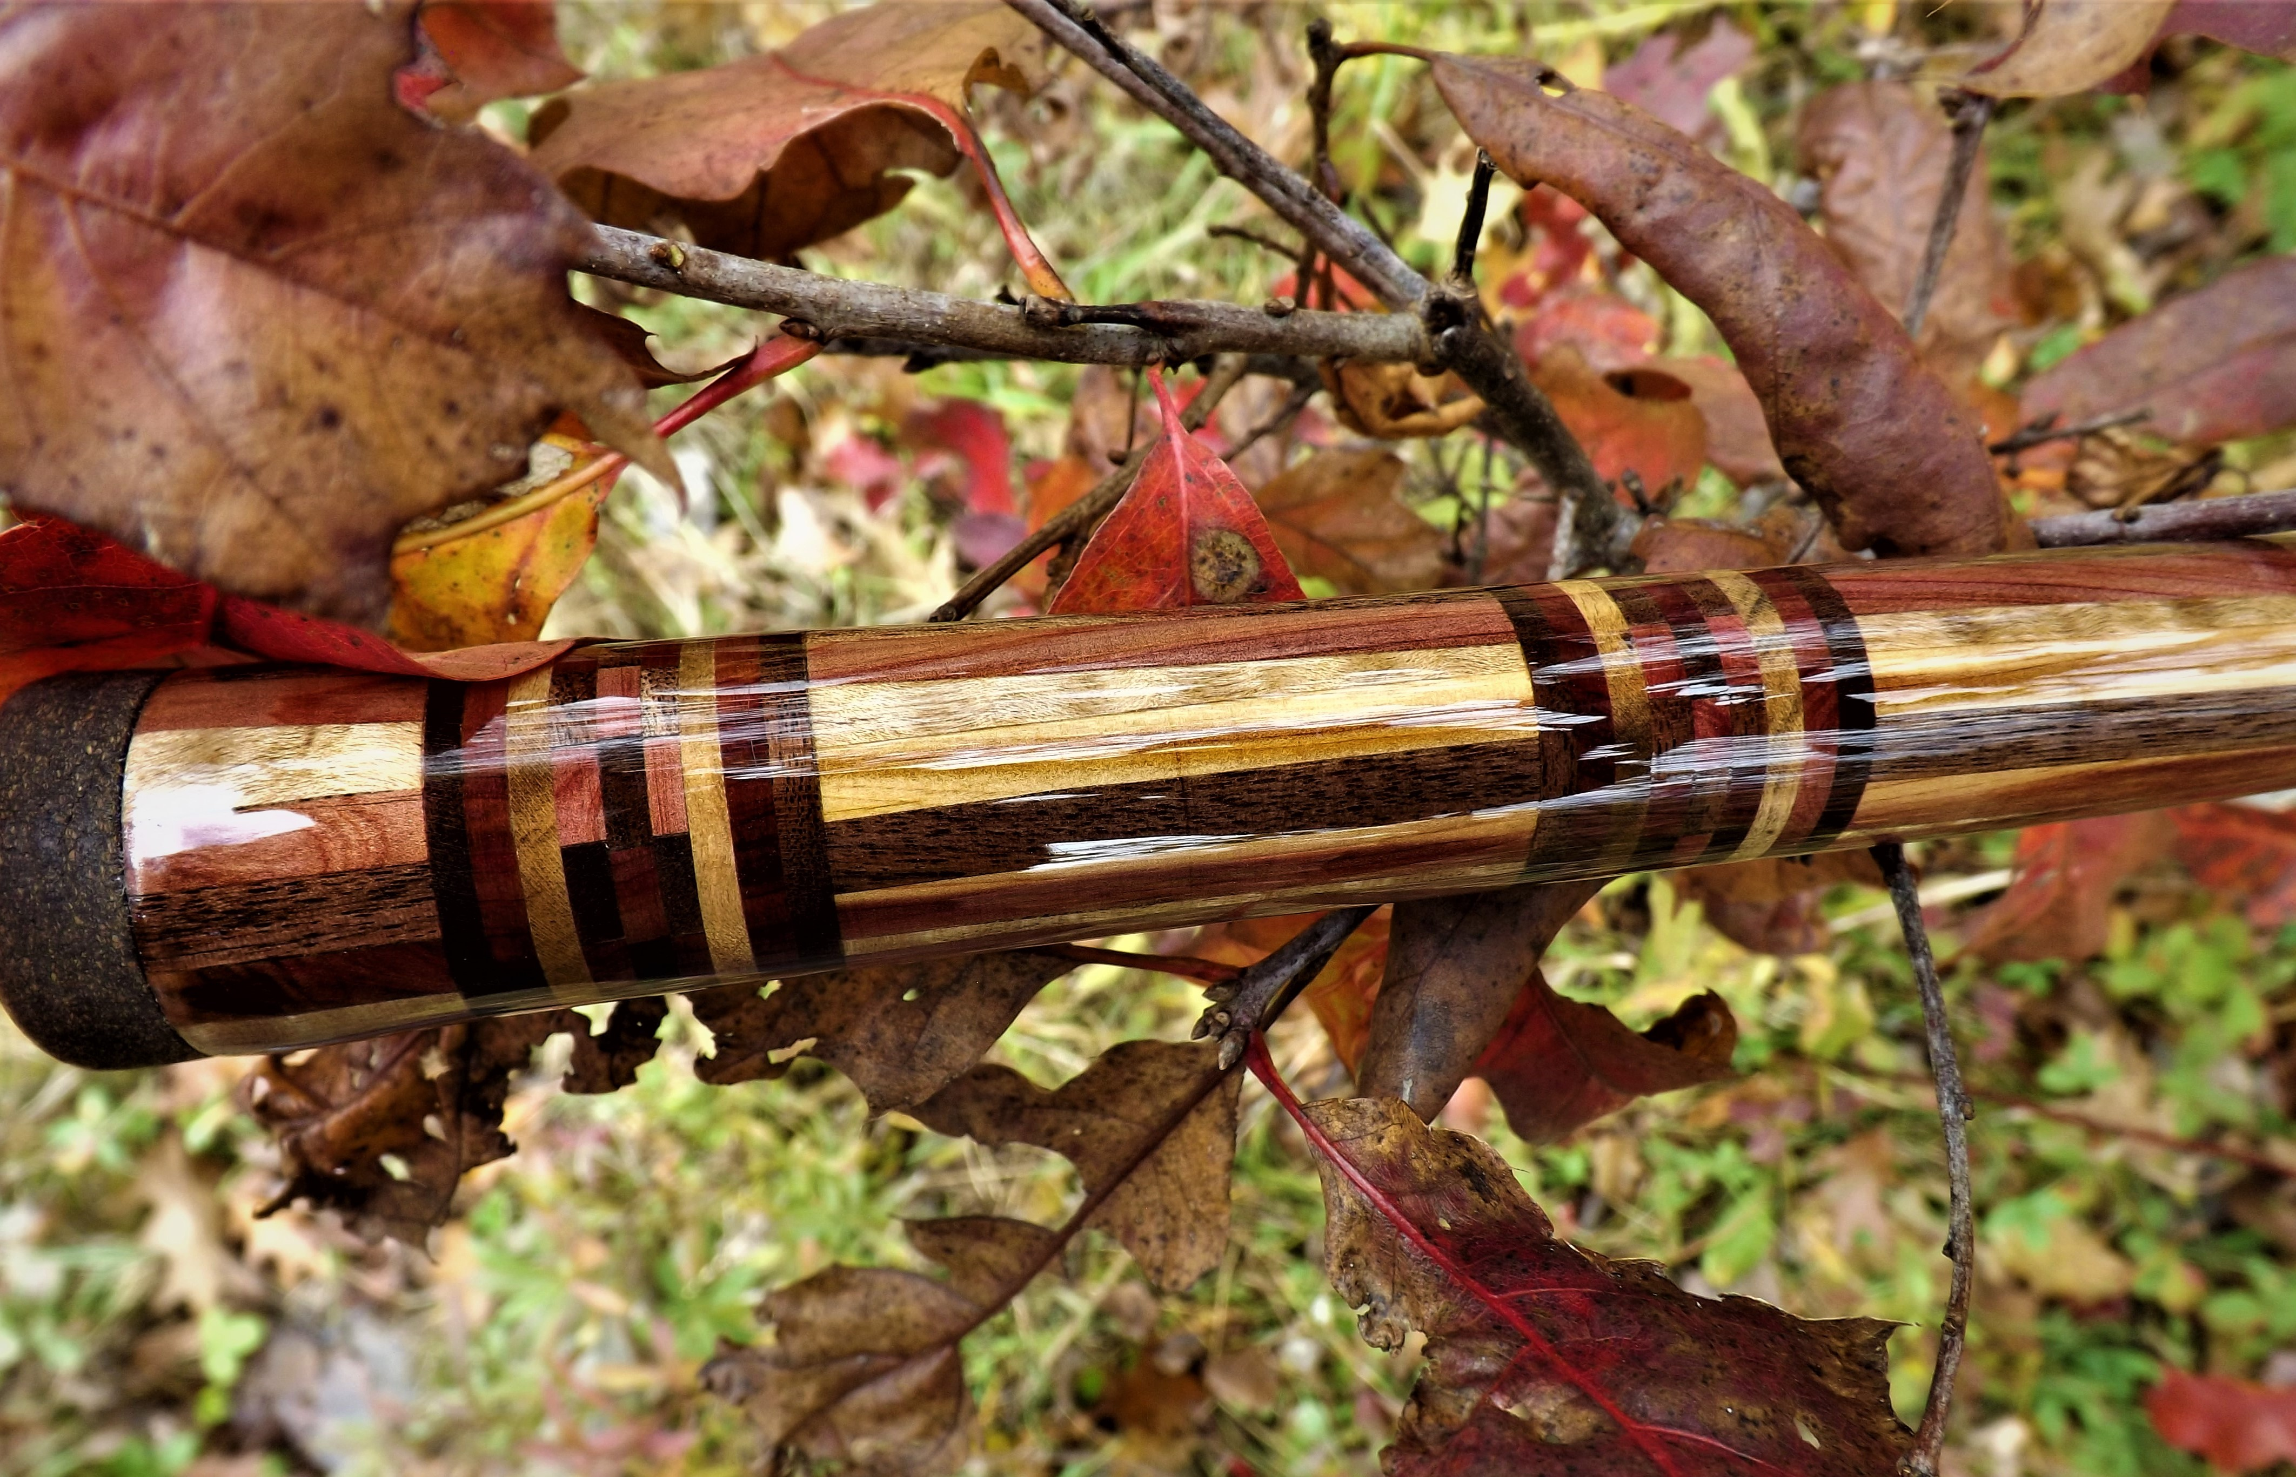
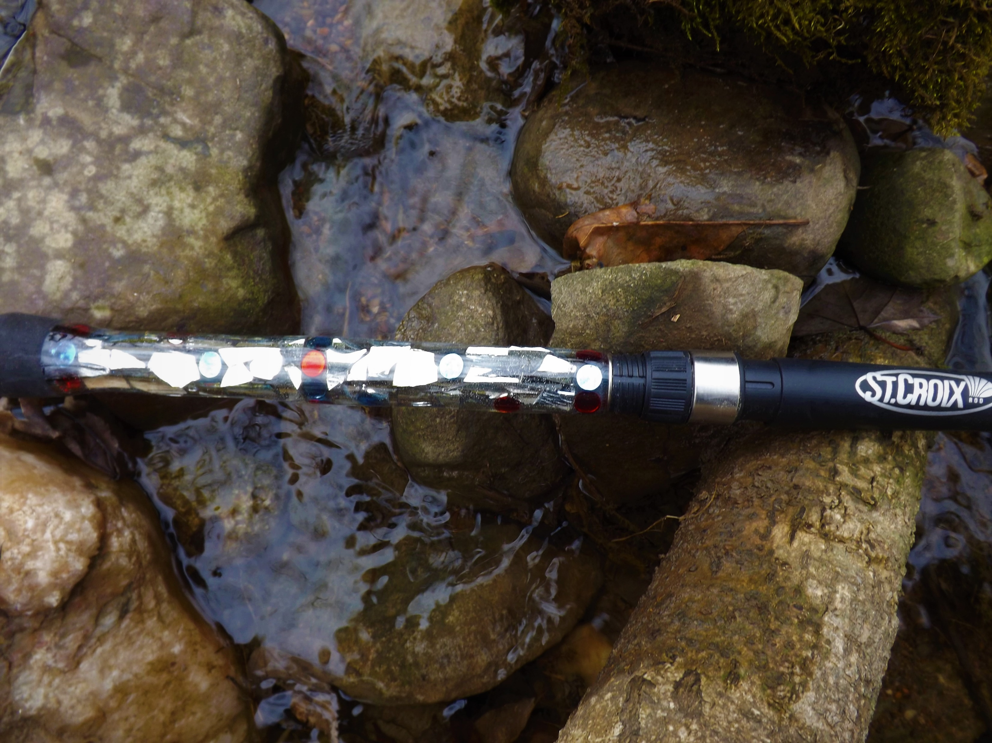
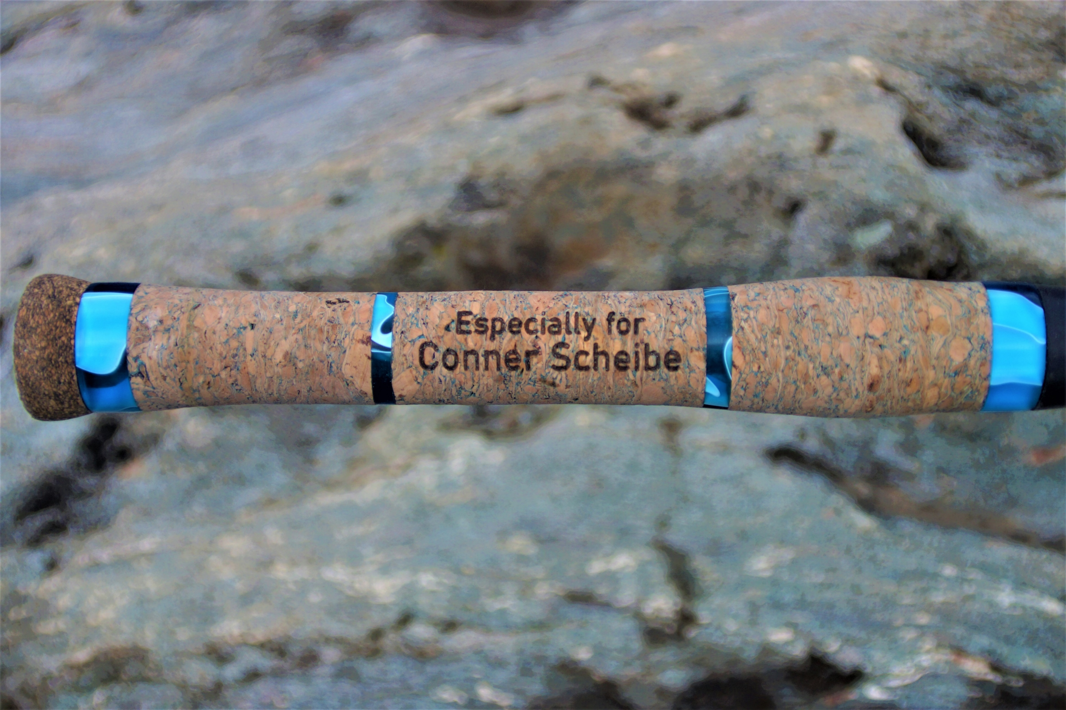
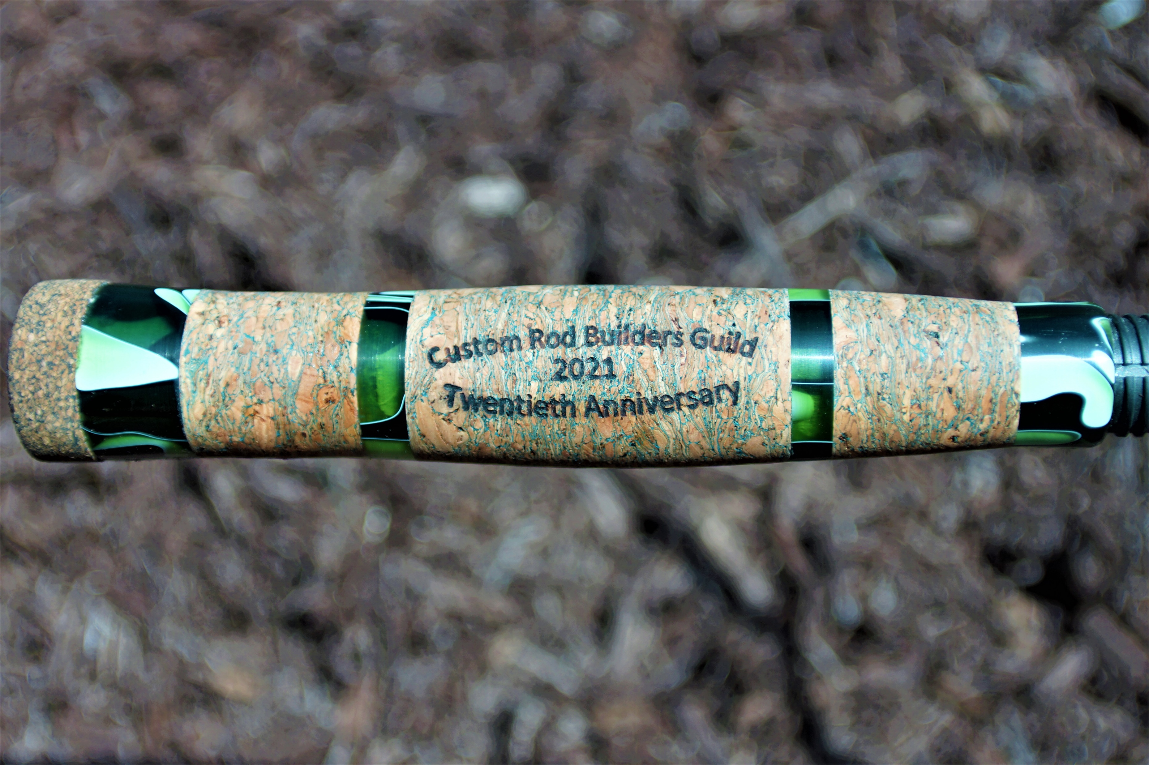
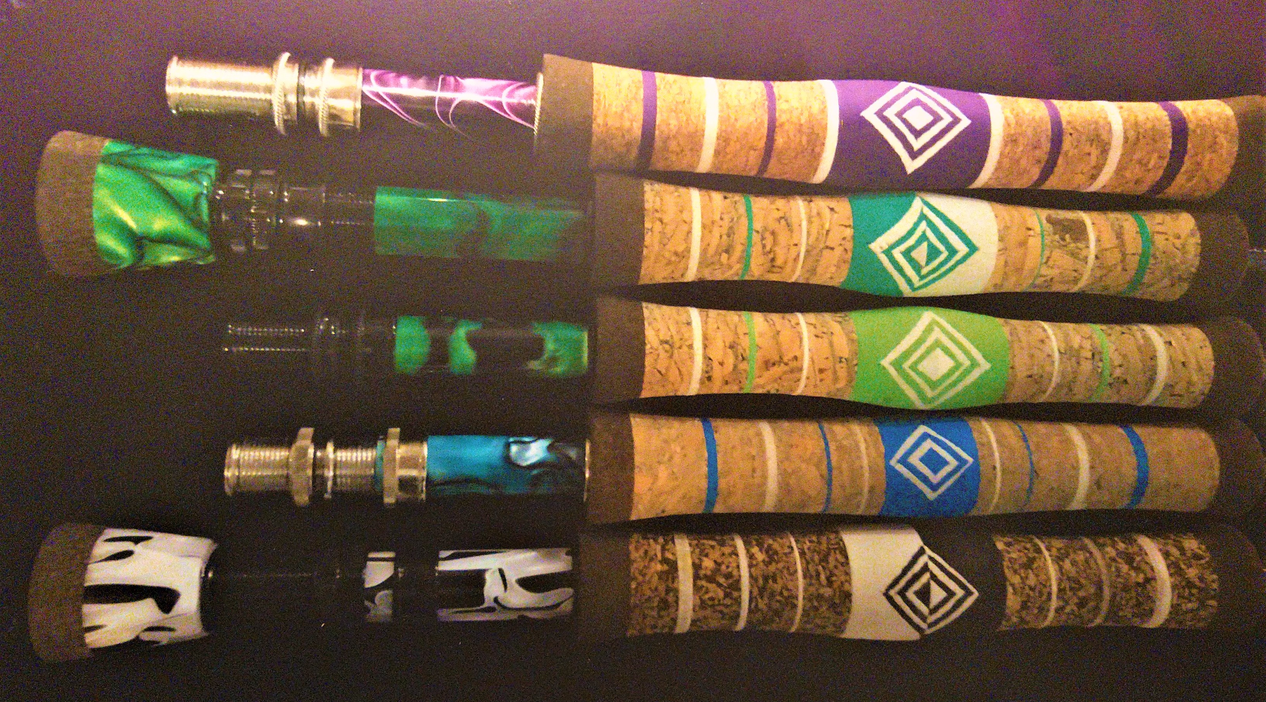
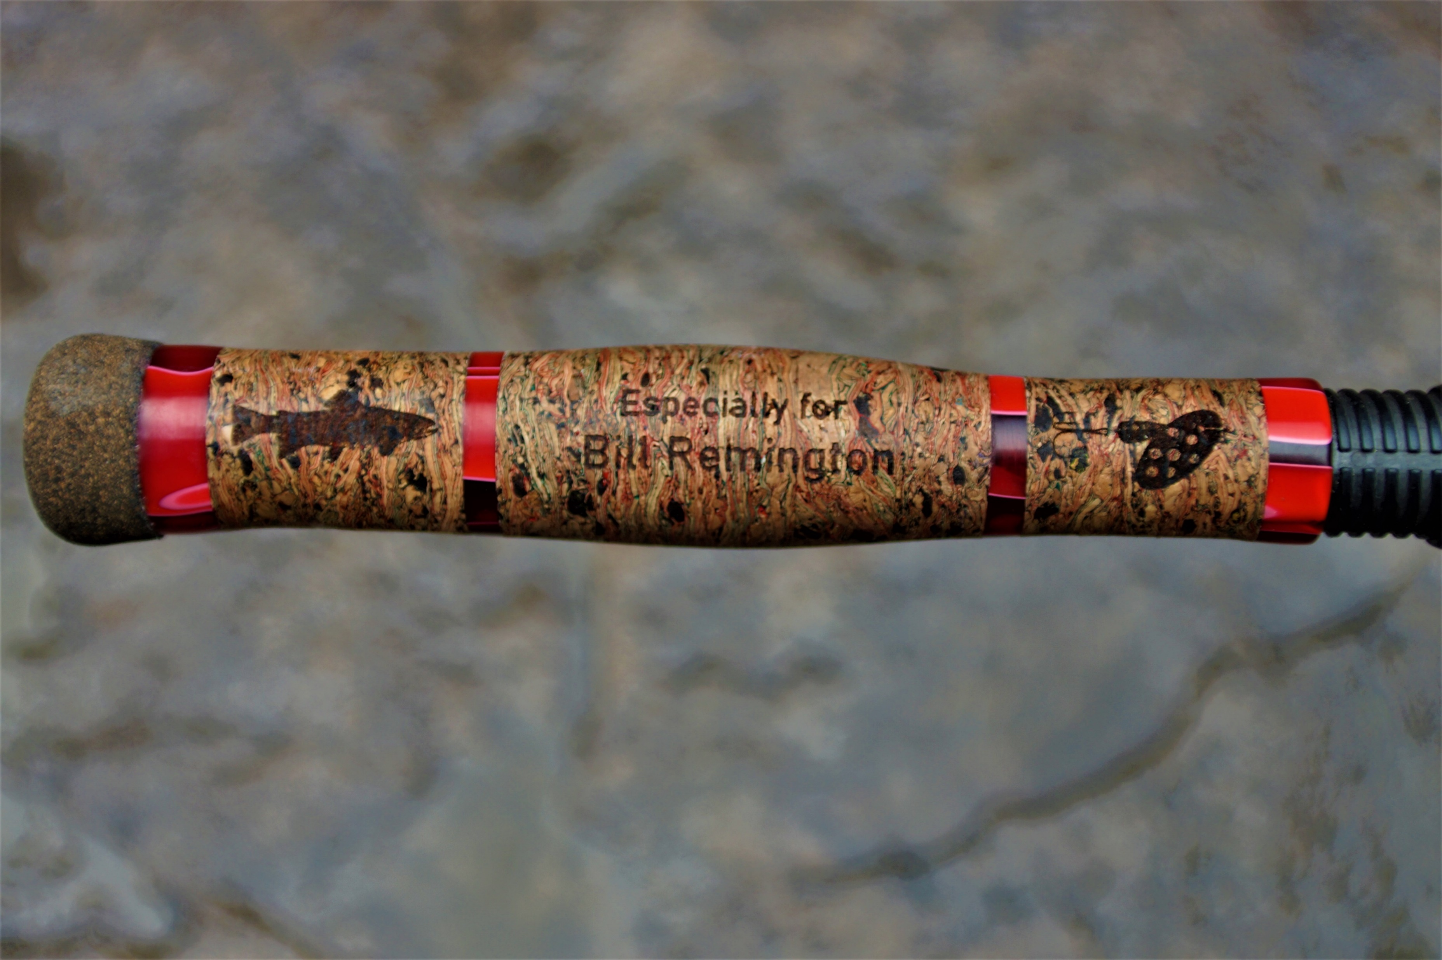
Let’s decorate the rod: Special grips

Slide 3
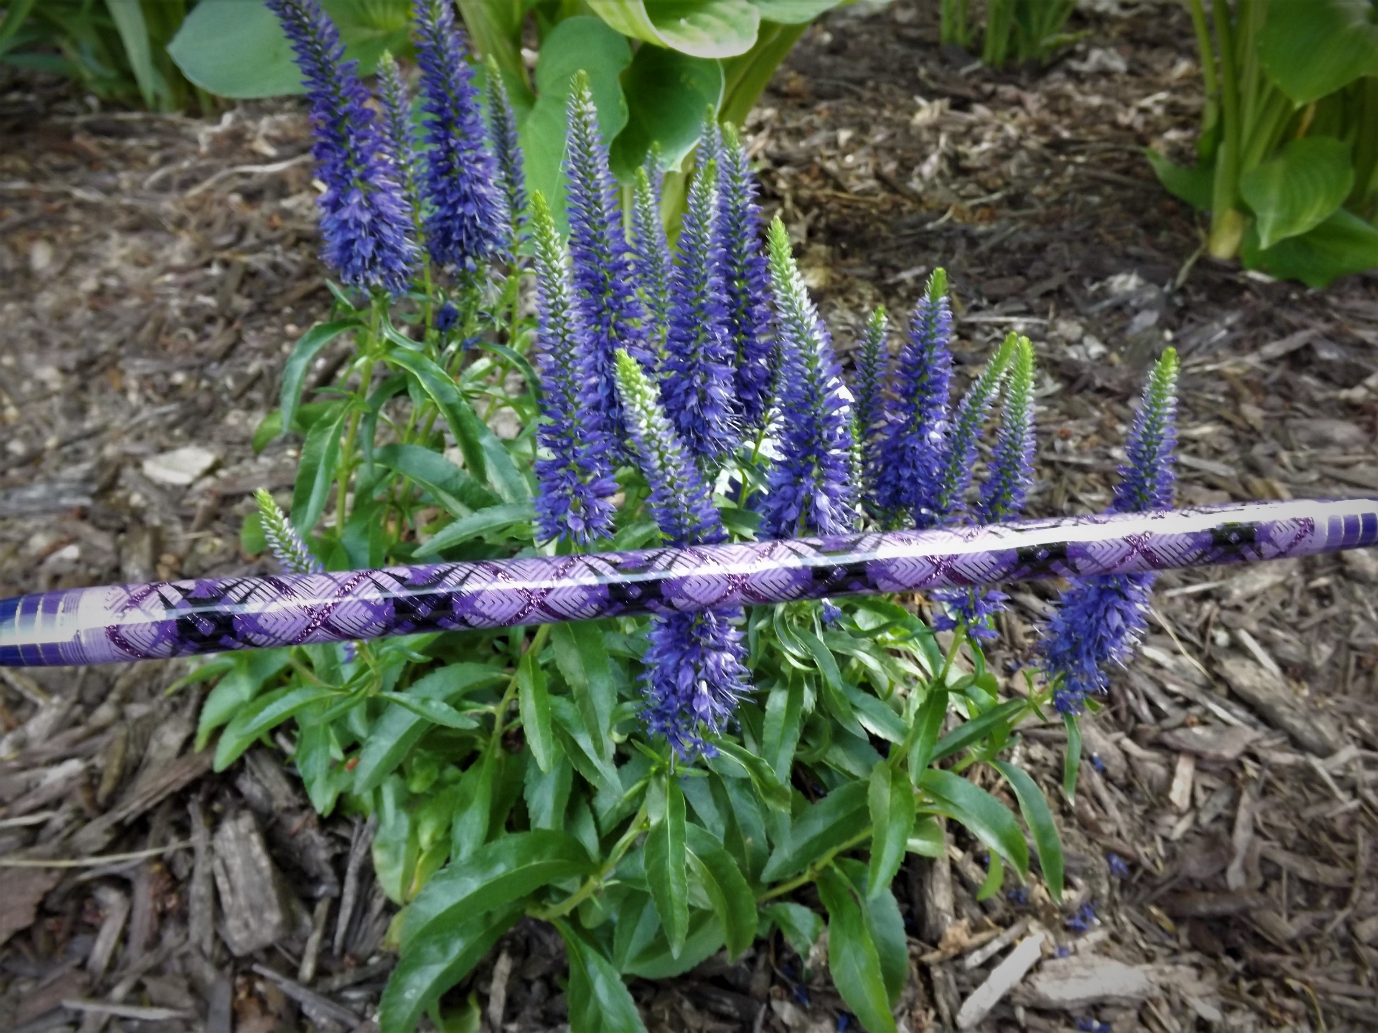
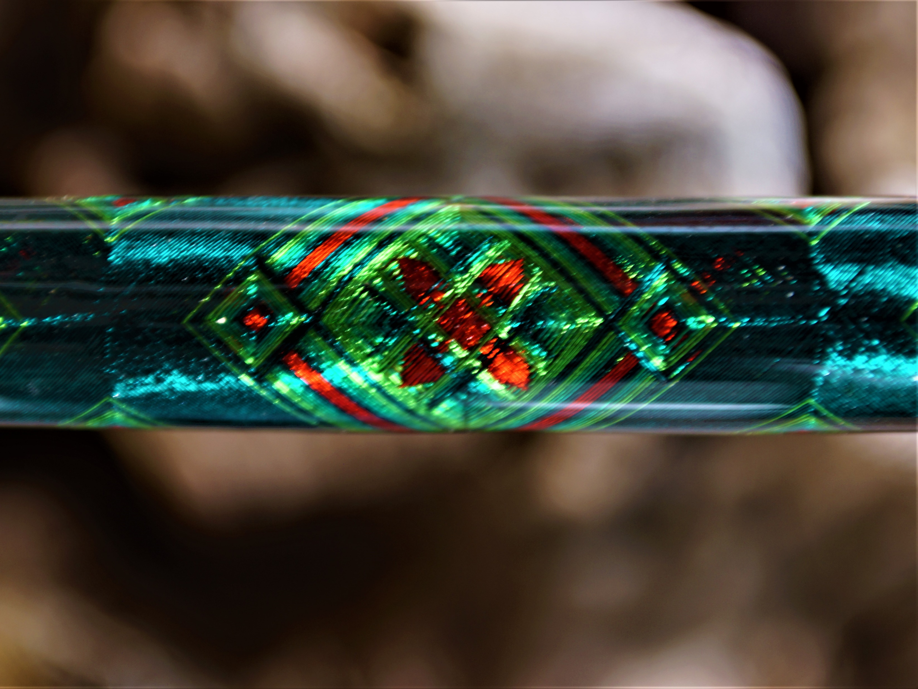
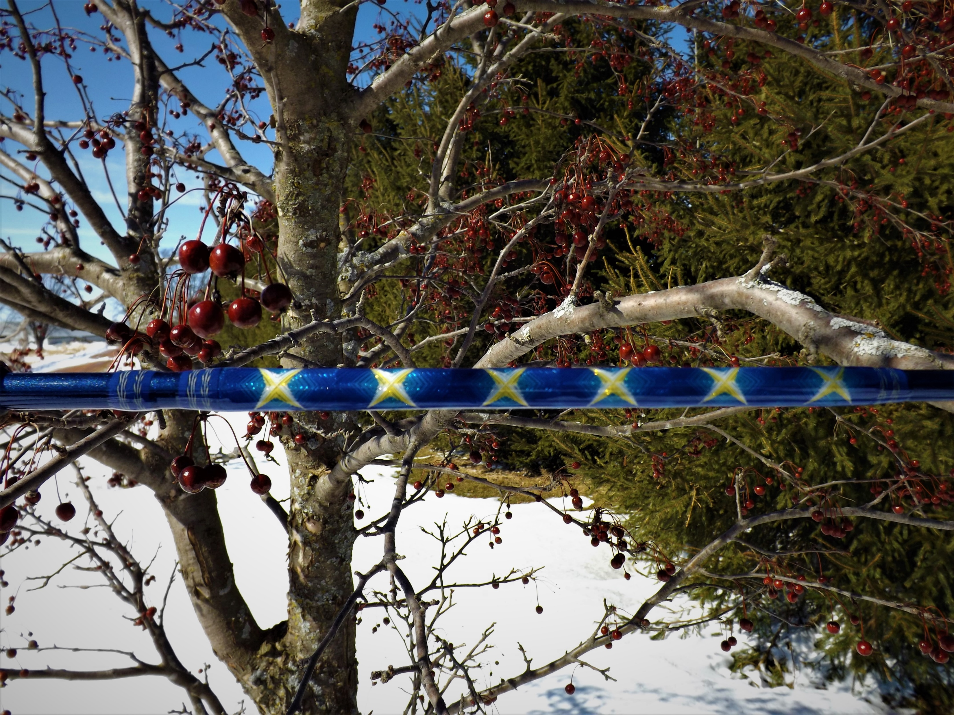
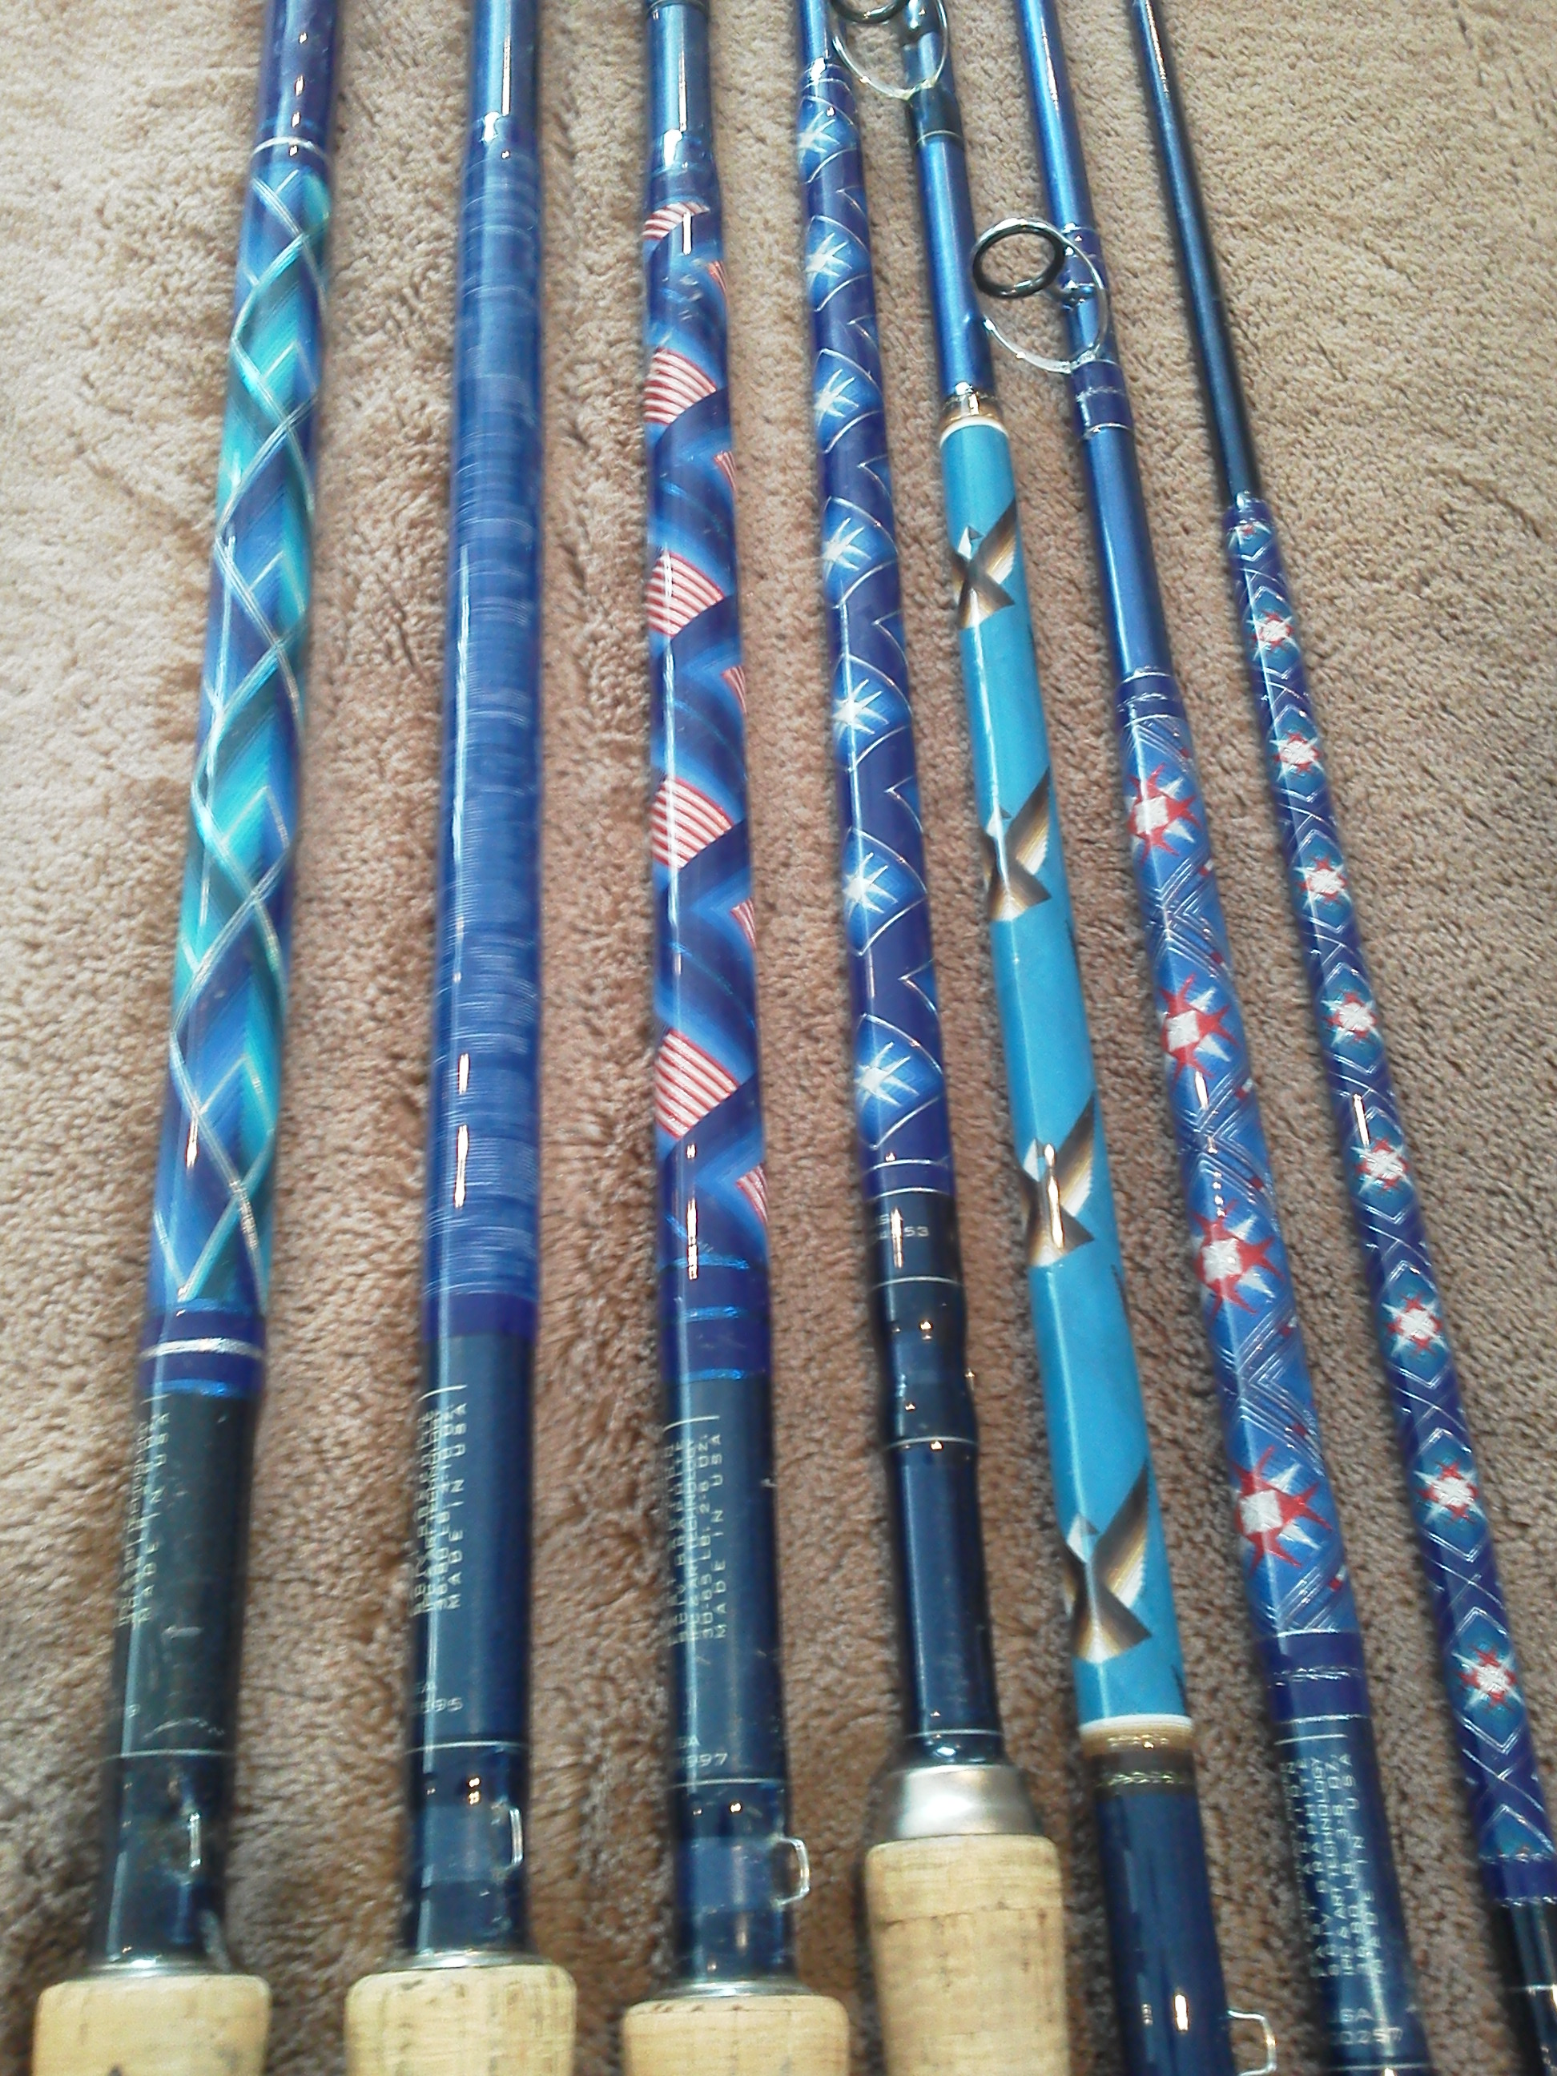
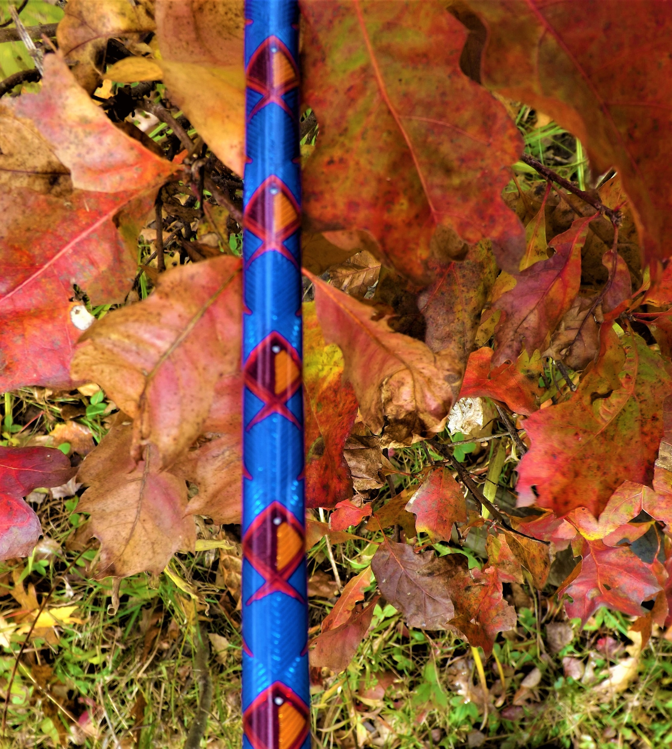
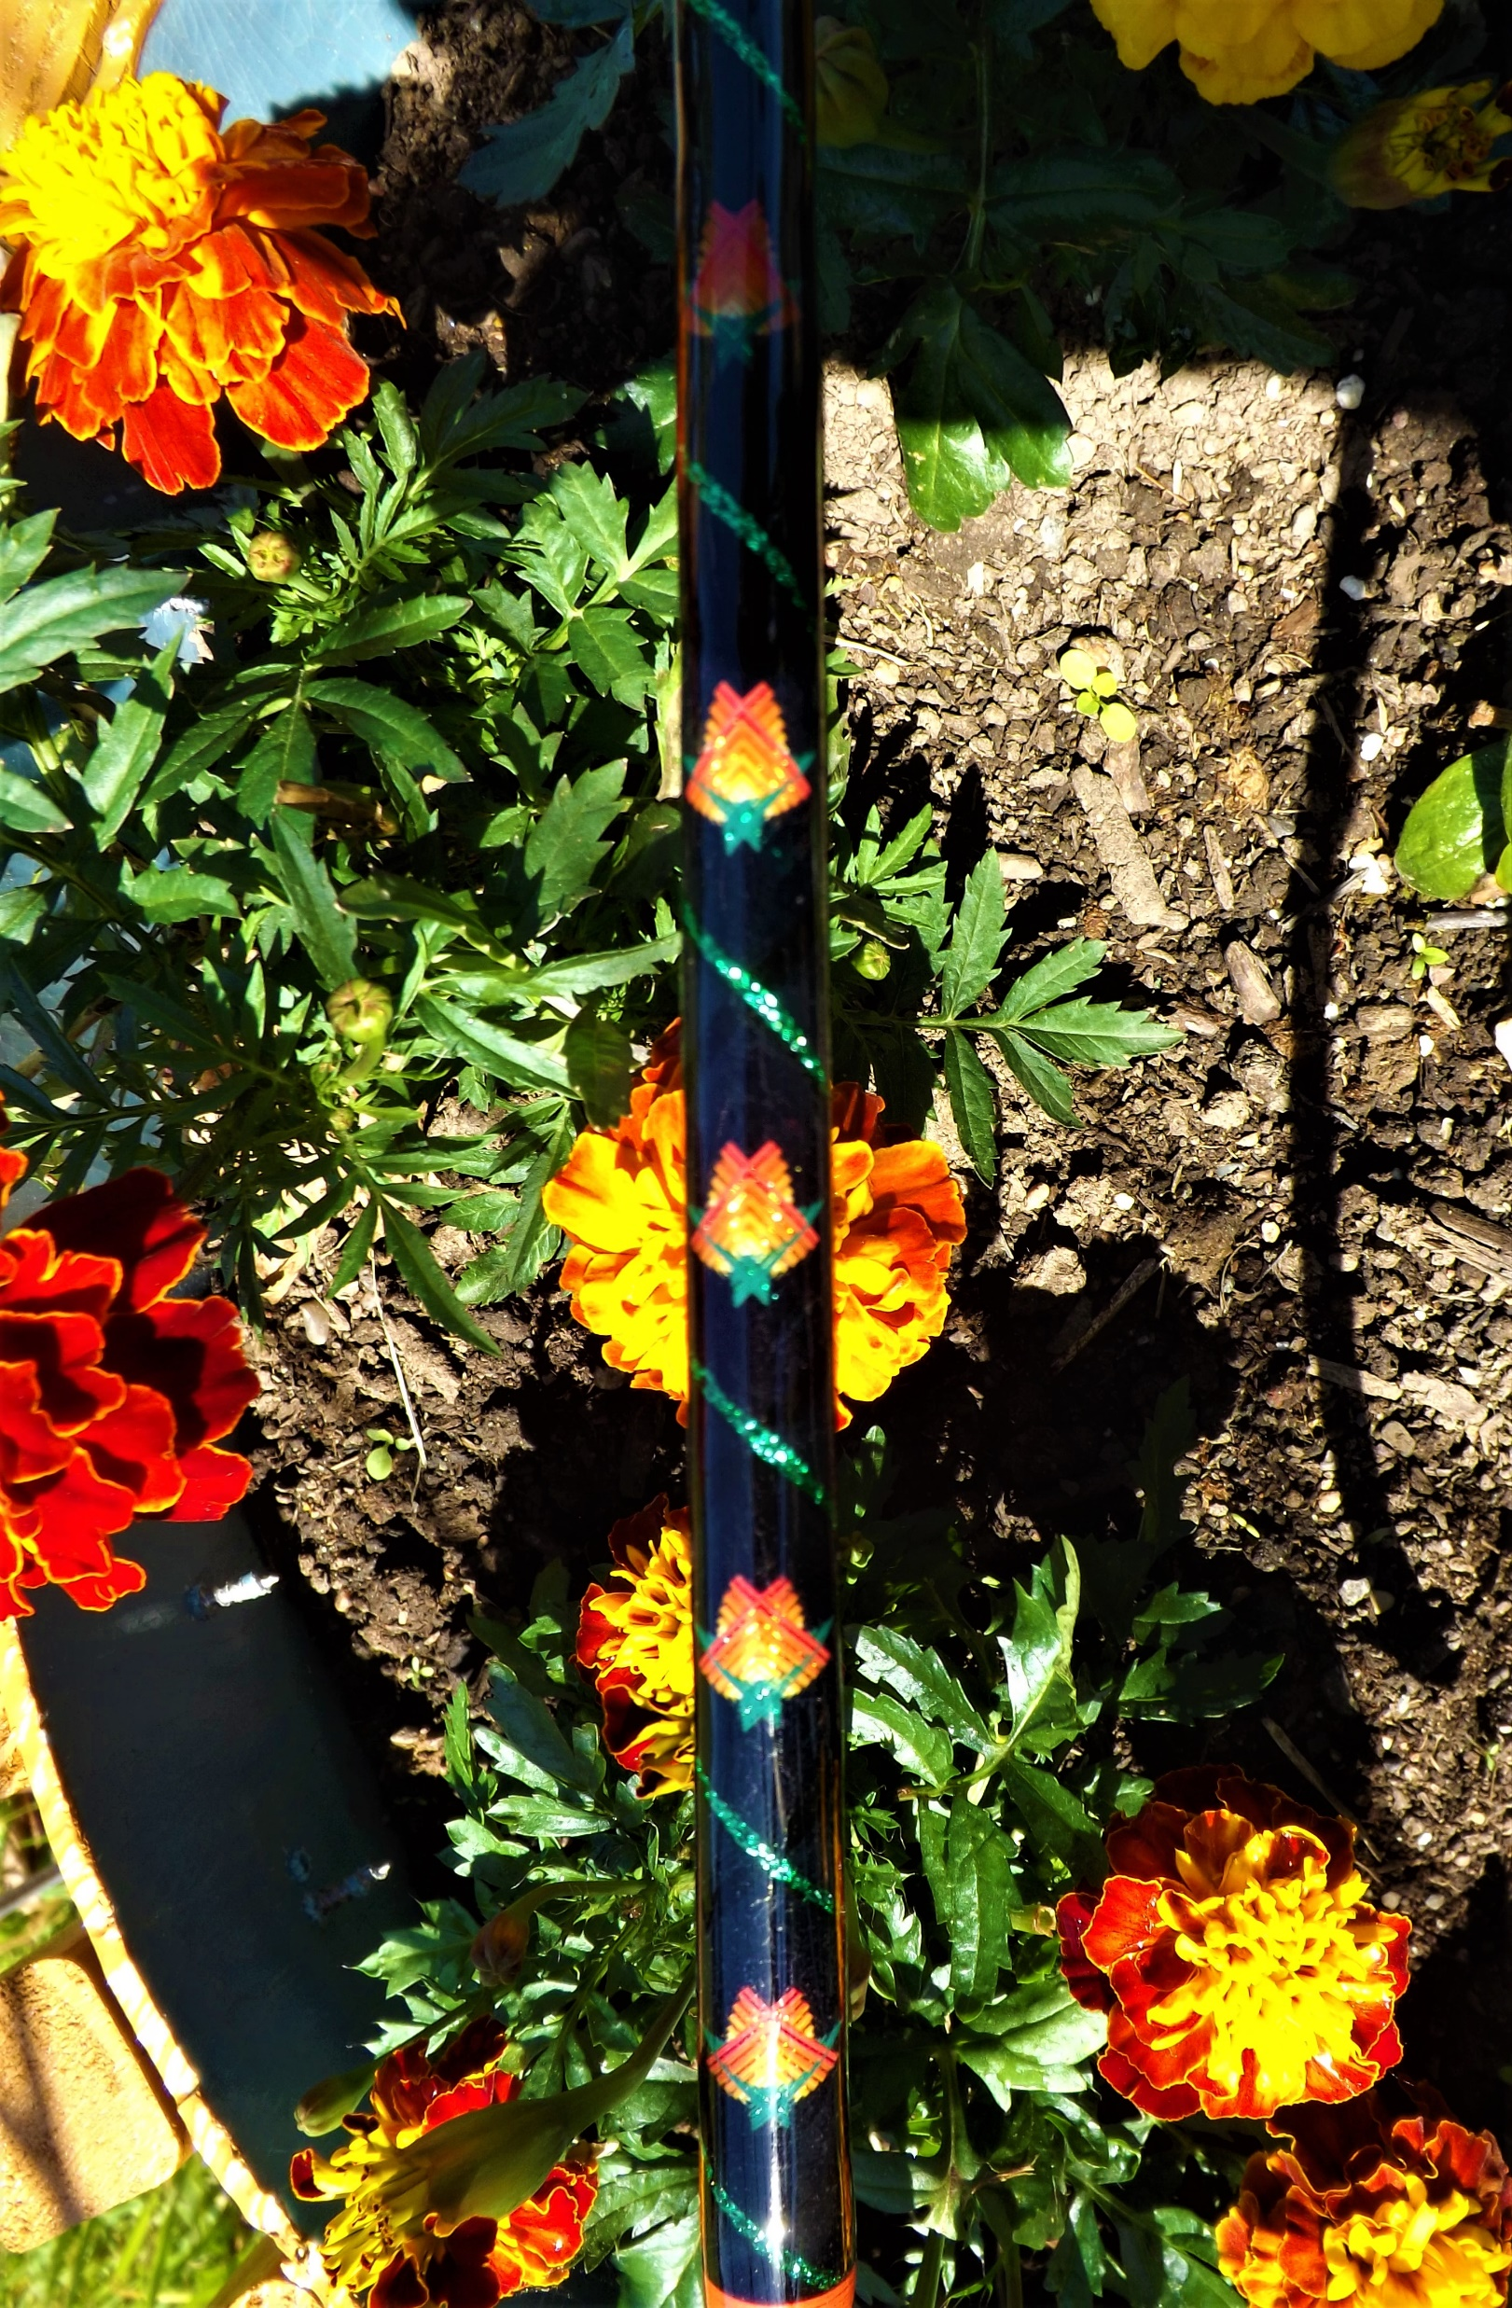
Putting the rod together: Thread Crosswraps

Slide 4
Join the Custom Rod Builders Guild
$35.00 Membership gets you a quarterly magazine packed with the How to’s of Rod Building. This membership allows you to attend regional events in Florida, Wisconsin, Iowa, and other states. Apply at https://rodguild.com.

Slide 5
Where to get supplies, components, tools.
American Tackle 800-516-1750 www.americantackle.us
Anglers Resource 251-943-4491 www.anglersresource.net
Anglers Workshop 877-741-7720 www.anglersworkshop.com
Batson Enterprises 877-875-2381 www.batsonenterprises.com
Get Bit Outdoors 407-542-7840 www.getbitoutdoors.com
Mudhole 866-790-7637 www.mudhole.com
RODgeeks 800-826-7042 www.rodgeeks.com
St Croix 800-826-7042 www.stcroixrods.com
VooDoo Custom Rods 337-504-2669 www.voodoorods.com

Slide 6
Rod Building Questions
John Sturm
Call or text 715-218-4196
Email jsturm3415@gmail.com

